Slide 1
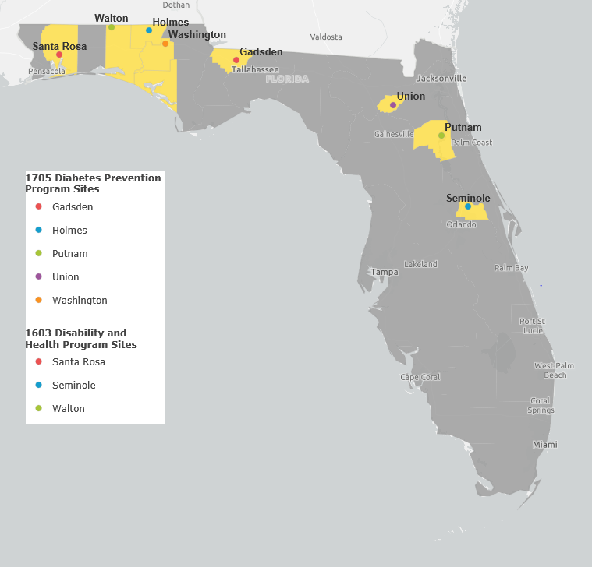
Reducing the Prevalence of Diabetes Among Persons with Disabilities (PWD) in Florida, 2018
Bryan Russell; Patrick Hodge, MPH; Kianga Tucker, MHA
Florida Department of Health, Bureau of Chronic Disease Prevention
Background
The National Diabetes Prevention Program (DPP) is an evidence-based lifestyle change program designed to prevent or delay the onset of type 2 diabetes. This program helps participants develop healthy habits, such as increasing physical activity and improving nutrition in order to maintain a 5-7% weight loss and lower their A1C level. This intervention has been shown to reduce participants’ risk of developing type 2 diabetes by 58%.²
In Florida, this initiative is funded through two sources:
Disability and Health Program (DHP) five year CDC grant (1603) to improve the health of PWD.
National Association of Chronic Disease Directors (NACDD) (1705 Grant) to implement “Prevent T2 for All” with a focus on serving minority and vulnerable populations, including PWD and persons without disabilities (PWoD).
Working Together to Reduce Diabetes Among Persons with Disabilities
The Disability and Health Program collaborated with the Florida Diabetes Program, NCHPAD and NACDD to identify three existing DPP providers to serve as pilot sites and implement the adapted curriculum “Prevent T2 for All.” During this process, the pilot sites established partnerships with their local Centers for Independent Living, local community centers and faith-based organizations to recruit and enroll PWD.
Beginning in 2019, the DHP and Special Olympics Florida will review “Prevent T2 for All” curriculum to identify ways to modify and make accommodations for persons with intellectual or developmental disabilities. Any modifications needed will be implemented during this programmatic year.
Partnership and Process Diagram
Barriers to Implementation
Facilitators to Implementation
Adapted DPP Pilot Sites, 2018
Next Steps/Future Plans
Expand the “Prevent T2 for All” programs to CIL sites across the state.
Adapt current Diabetes Self-Management Education programs to be more inclusive for persons with disabilities.
Expand participant recruitment and retention efforts.
Pilot test additional inclusive DPP with alternative timelines.
Centers for Disease Control and Prevention | National Association of Chronic Disease Directors
National Center on Health, Physical Activity and Disability | County Health Departments
Florida Centers for Independent Living | Special Olympics Florida
Community Centers | Faith-based Organizations
Engagement & retention of clients with disabilities | CDC Recognition Requirements | Limited Accessible Transportation options
Internal and External Partnerships | Ease of conducting accessibility assessments of pilot site locations
Flexibility of Lifestyle Coach Training | Evaluation and Data Collection
Floridians With Pre-Diabetes, 2017¹
Floridians With Diabetes, 2017¹
1. Curriculum development (NCHPAD; SOFL)
3. Training DPP staff (CHD; DHP; FDOH; CILs)
4. Purchasing adapted equipment (CHD; CILs)
5. Recruitment and marketing to PWD (CILs; SOFL; CC; FBO)
7. Data collection (CHD; DHP; CILs)
2. Selecting pilot sites (DHP; Diabetes Program; CILs)
6. Conducting DPP classes (CHD; CC; FBO; CILs)
1) Center for Independent Living (CIL)
2) Community Center (CC)
3) County Health Department (CHD)
4) Disability and Health Program (DHP)
5) Faith-based Organization (FBO)
6) Florida Department of Health (FDOH)
7) National Association of Chronic Disease Directors (NACDD)
8) National Center on Health, Physical Activity and Disability (NCHPAD)
9) Special Olympics Florida (SOFL)
Diabetes Risk Factors, 2017¹
References
Centers for Disease Control and Prevention. (2017). Disability and Health Data System. Behavioral Risk Factor Surveillance System Estimates. Retrieved from https://www.cdc.gov/ncbddd/disabilityandhealth/dhds/index.html.
Centers for Disease Control and Prevention. (2018). National Diabetes Prevention Program Infographic. https://www.cdc.gov/diabetes/prevention/pdf/NDPP_Infographic.pdf
This publication was supported by the Grant or Cooperative Agreement Number, NU27DD000012 and NU58DP006363, funded by the Centers for Disease Control and Prevention. Its contents are solely the responsibility of the authors and do not necessarily represent the official views of the Centers for Disease Control and Prevention or the U.S. Department of Health and Human Services.
2019 Association of University Centers on Disability (AUCD) Annual Conference, Washington, D.C. Presented November 18, 2019

